Slide 1
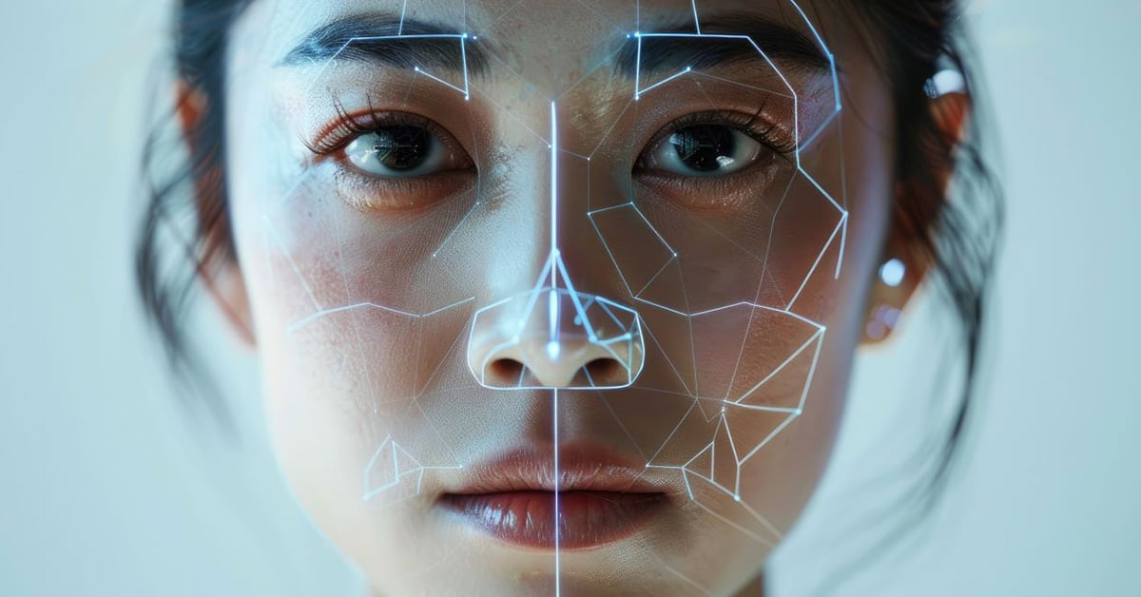

Unmasking Reality: The Battle Against Deepfake Fraud
Team
The Loop Breakers
HACKFEST 2025

Slide 2

INTRODUCTION
Would You Believe Your Eyes… If $243,000 Vanished After a Phone Call?
In 2020, criminals used AI voice cloning to impersonate a CEO and steal $243,000 from a Hong Kong bank. The future isn’t sci-fi anymore—it’s synthetic. News link
HACKFEST 2025

Slide 3
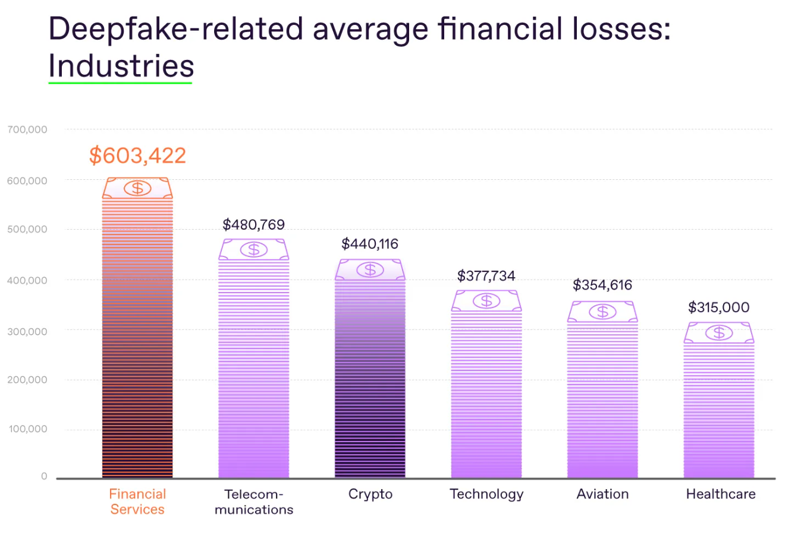
PILLAR I
THE PROBLEM – Deepfakes as Corporate Weapons
According to Signicat's report. Link
Three years ago: Deepfake attacks accounted for just 0.1% of all fraud attempts.
Today: They now represent 6.5% of cases—roughly 1 in 15 fraud attempts.
Growth Rate: A staggering 2,137% increase over three years.

Slide 4
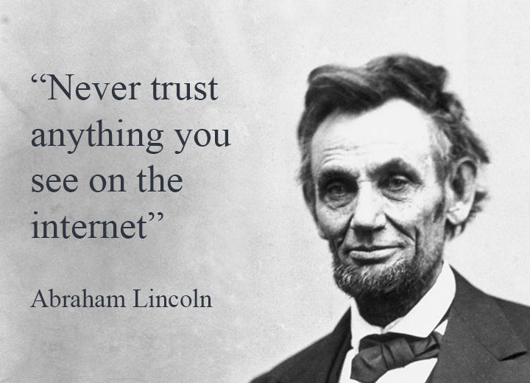

You’ve probably heard this famous quote before…
It is also fake…

Slide 5
Types of Deepfake frauds…
Audio Deepfakes (Voice Cloning) | AI mimics a person’s voice using short voice samples (e.g., from social media or phone calls).
Video Deepfakes (Synthetic Video) | AI generates realistic fake videos by swapping faces/expressions or creating entirely synthetic characters.
Image Deepfakes (Photo Manipulation) | AI alters or generates fake photos (e.g., forged IDs, fake profile pictures).
Text Deepfakes (AI-Generated Content) | LLMs (like ChatGPT) mimic writing styles to create fake emails, legal documents, or chats.
Hybrid Deepfakes (Multimodal Manipulation) | Combines audio, video, and text for sophisticated scams (e.g., fake video calls with cloned voices).

Slide 6
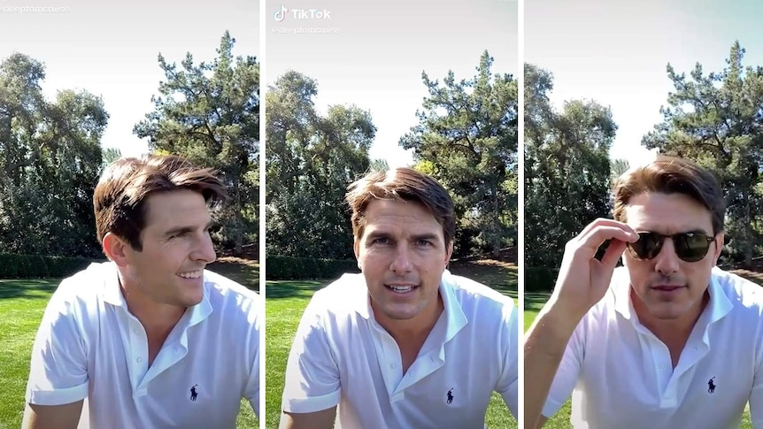

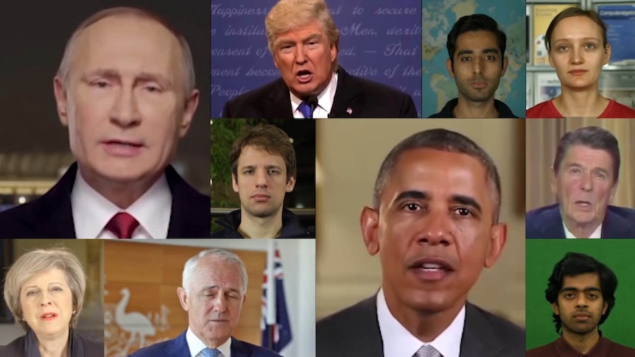
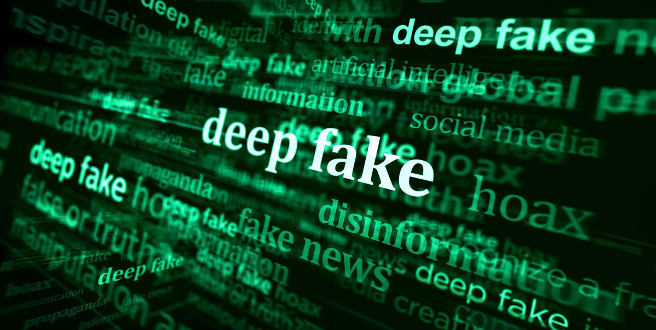
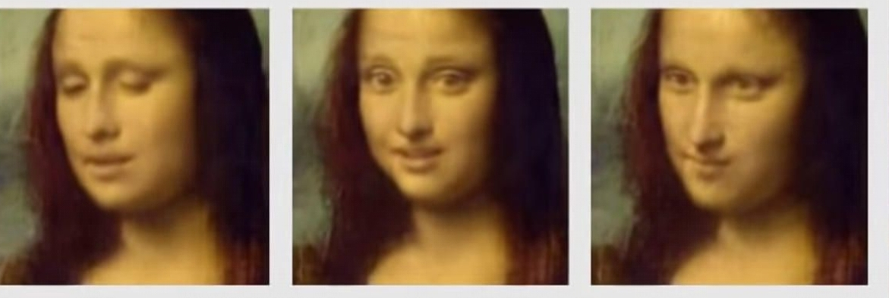
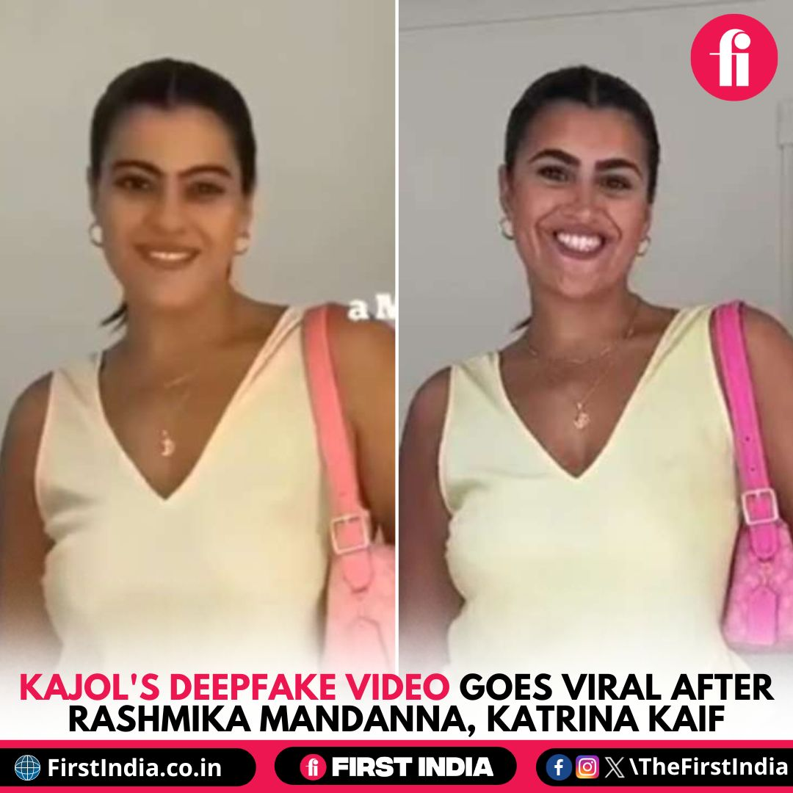
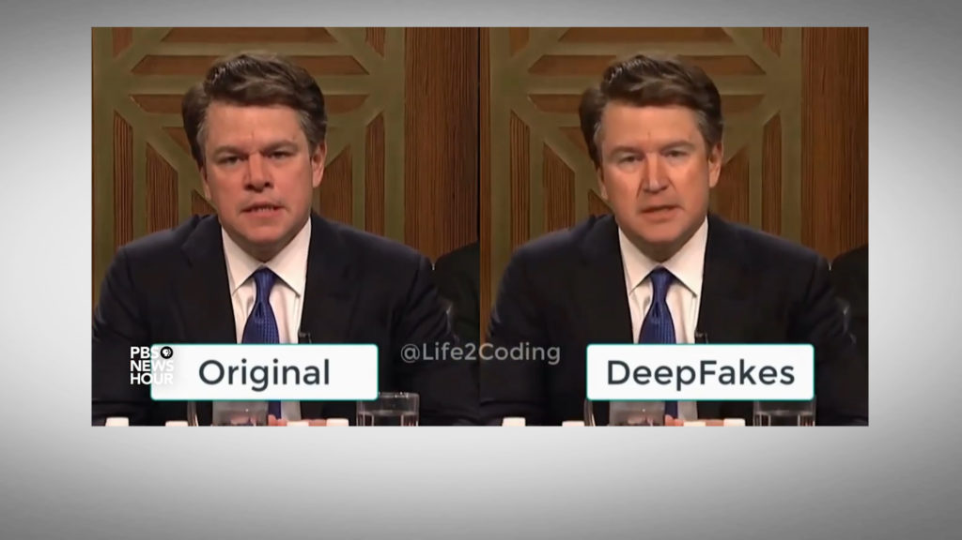
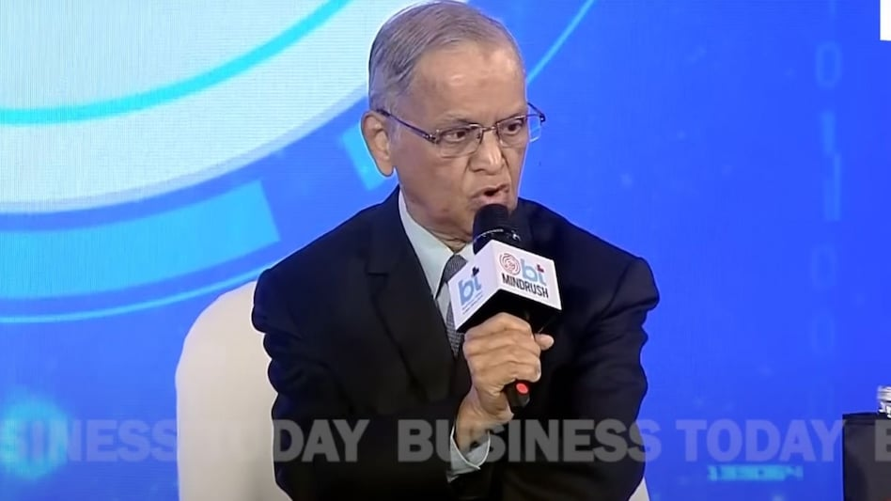
Analogy:
"Deepfakes are like counterfeit currency in a digital economy—indistinguishable at a glance, devastating when accepted."

Slide 7

PILLAR II
THE SYSTEM – How Deepfake Detection Works
We have identified five critical vulnerabilities in SAP-like ecosystems that are particularly susceptible to deepfake exploitation.
Our solution directly addresses these key threat vectors:

Slide 8
Problem 01
Problem 03
Impersonation of SAP Executives or Brand
Business Email Compromise (BEC) via SAP Systems
Problem 02
Problem 04
Supply Chain and Invoice Fraud
Vendor and Partner Impersonation

Slide 9
Problem 01
Executive/Brand Impersonation Shield
Technology Components:
Verified Media Watermarking: All official SAP executive communications are cryptographically signed
Deepfake Detection API: Real-time analysis of videos claiming SAP affiliation
Blockchain Registry: Public ledger of authentic SAP media assets
Scammers use deepfake videos/audio of SAP executives (e.g., Dietmar Hopp) to push fake investments, like the 'Immediate Matrix' scam, exploiting SAP’s brand trust to deceive victims globally.

Slide 10
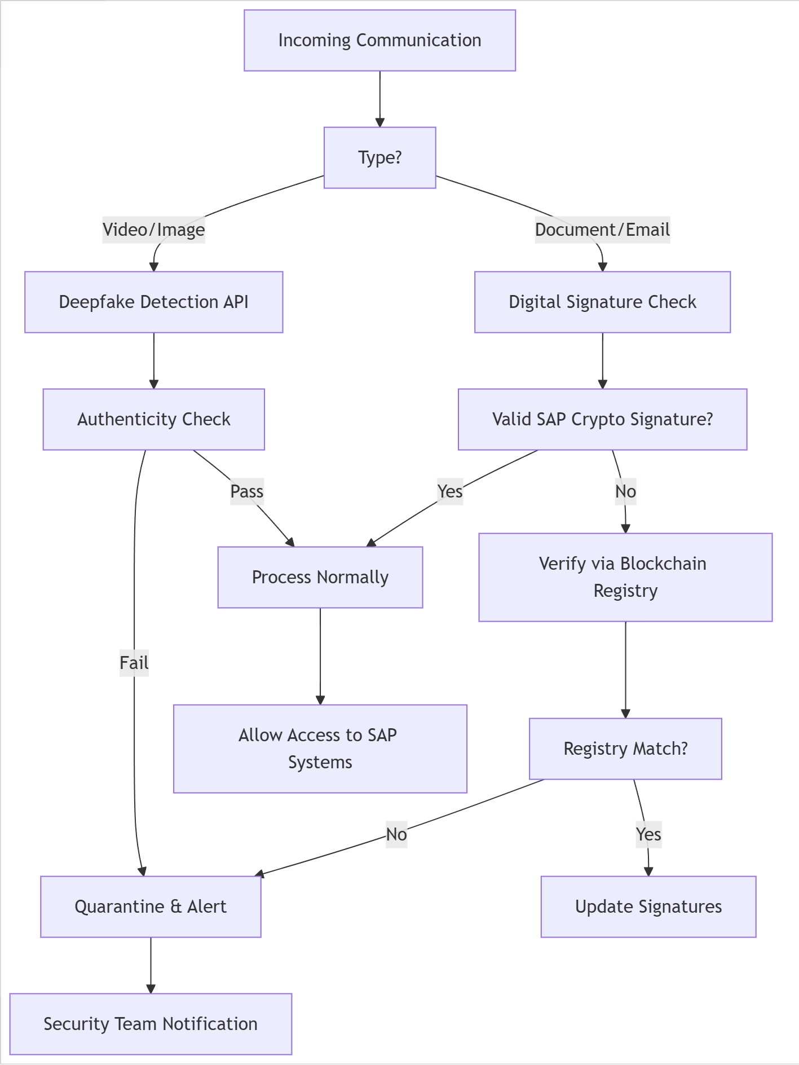
Flow-Chart

Slide 11
Problem 02
Smart Invoice Fraud Prevention
Technology Components:
AI Invoice Scanner: Detects GenAI-generated invoice anomalies
Vendor Identity Verification: Multi-factor authentication for supplier changes
Transaction Pattern Analysis: Machine learning monitors payment anomalies
SAP's supply chain tools face AI-powered invoice fraud, where criminals create flawless fake invoices or spoof vendors. High transaction volumes make manual detection difficult.

Slide 12
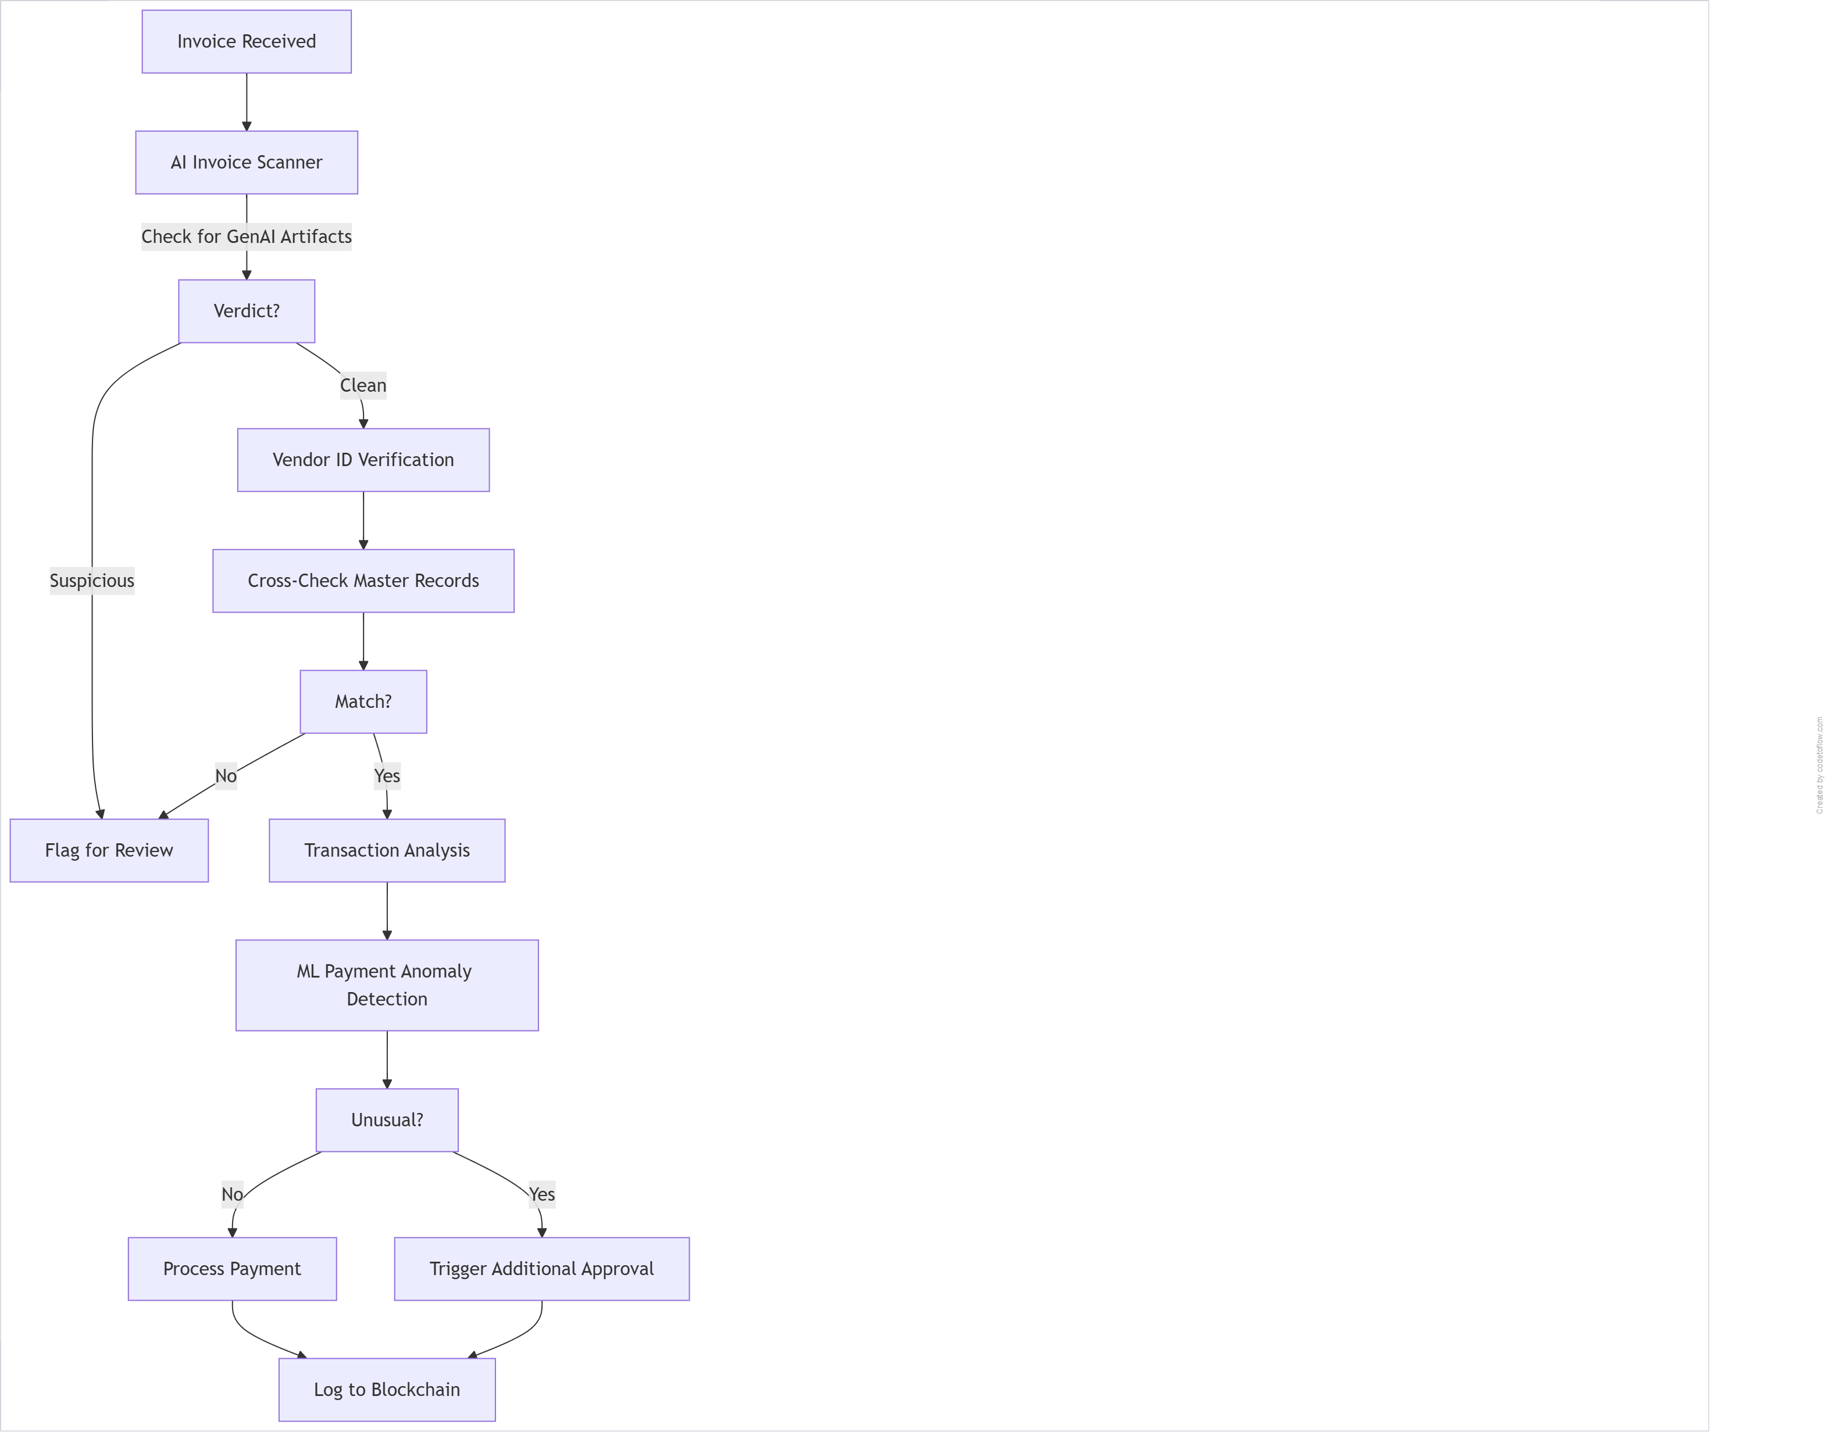
Flow-Chart

Slide 13
Problem 03
Secure Payment Authorization Protocol
BEC Protection Features:
Video Call Authentication: Real-time deepfake detection during financial approvals
Multi-Channel Verification: Payment requests require confirmation via separate system
Behavioral Biometrics: Analyzes typing patterns and mouse movements
Deepfakes enable executive impersonation in SAP payment workflows, as seen in Hong Kong's $25M CFO video call scam. SAP's financial integration makes it a prime target.

Slide 14
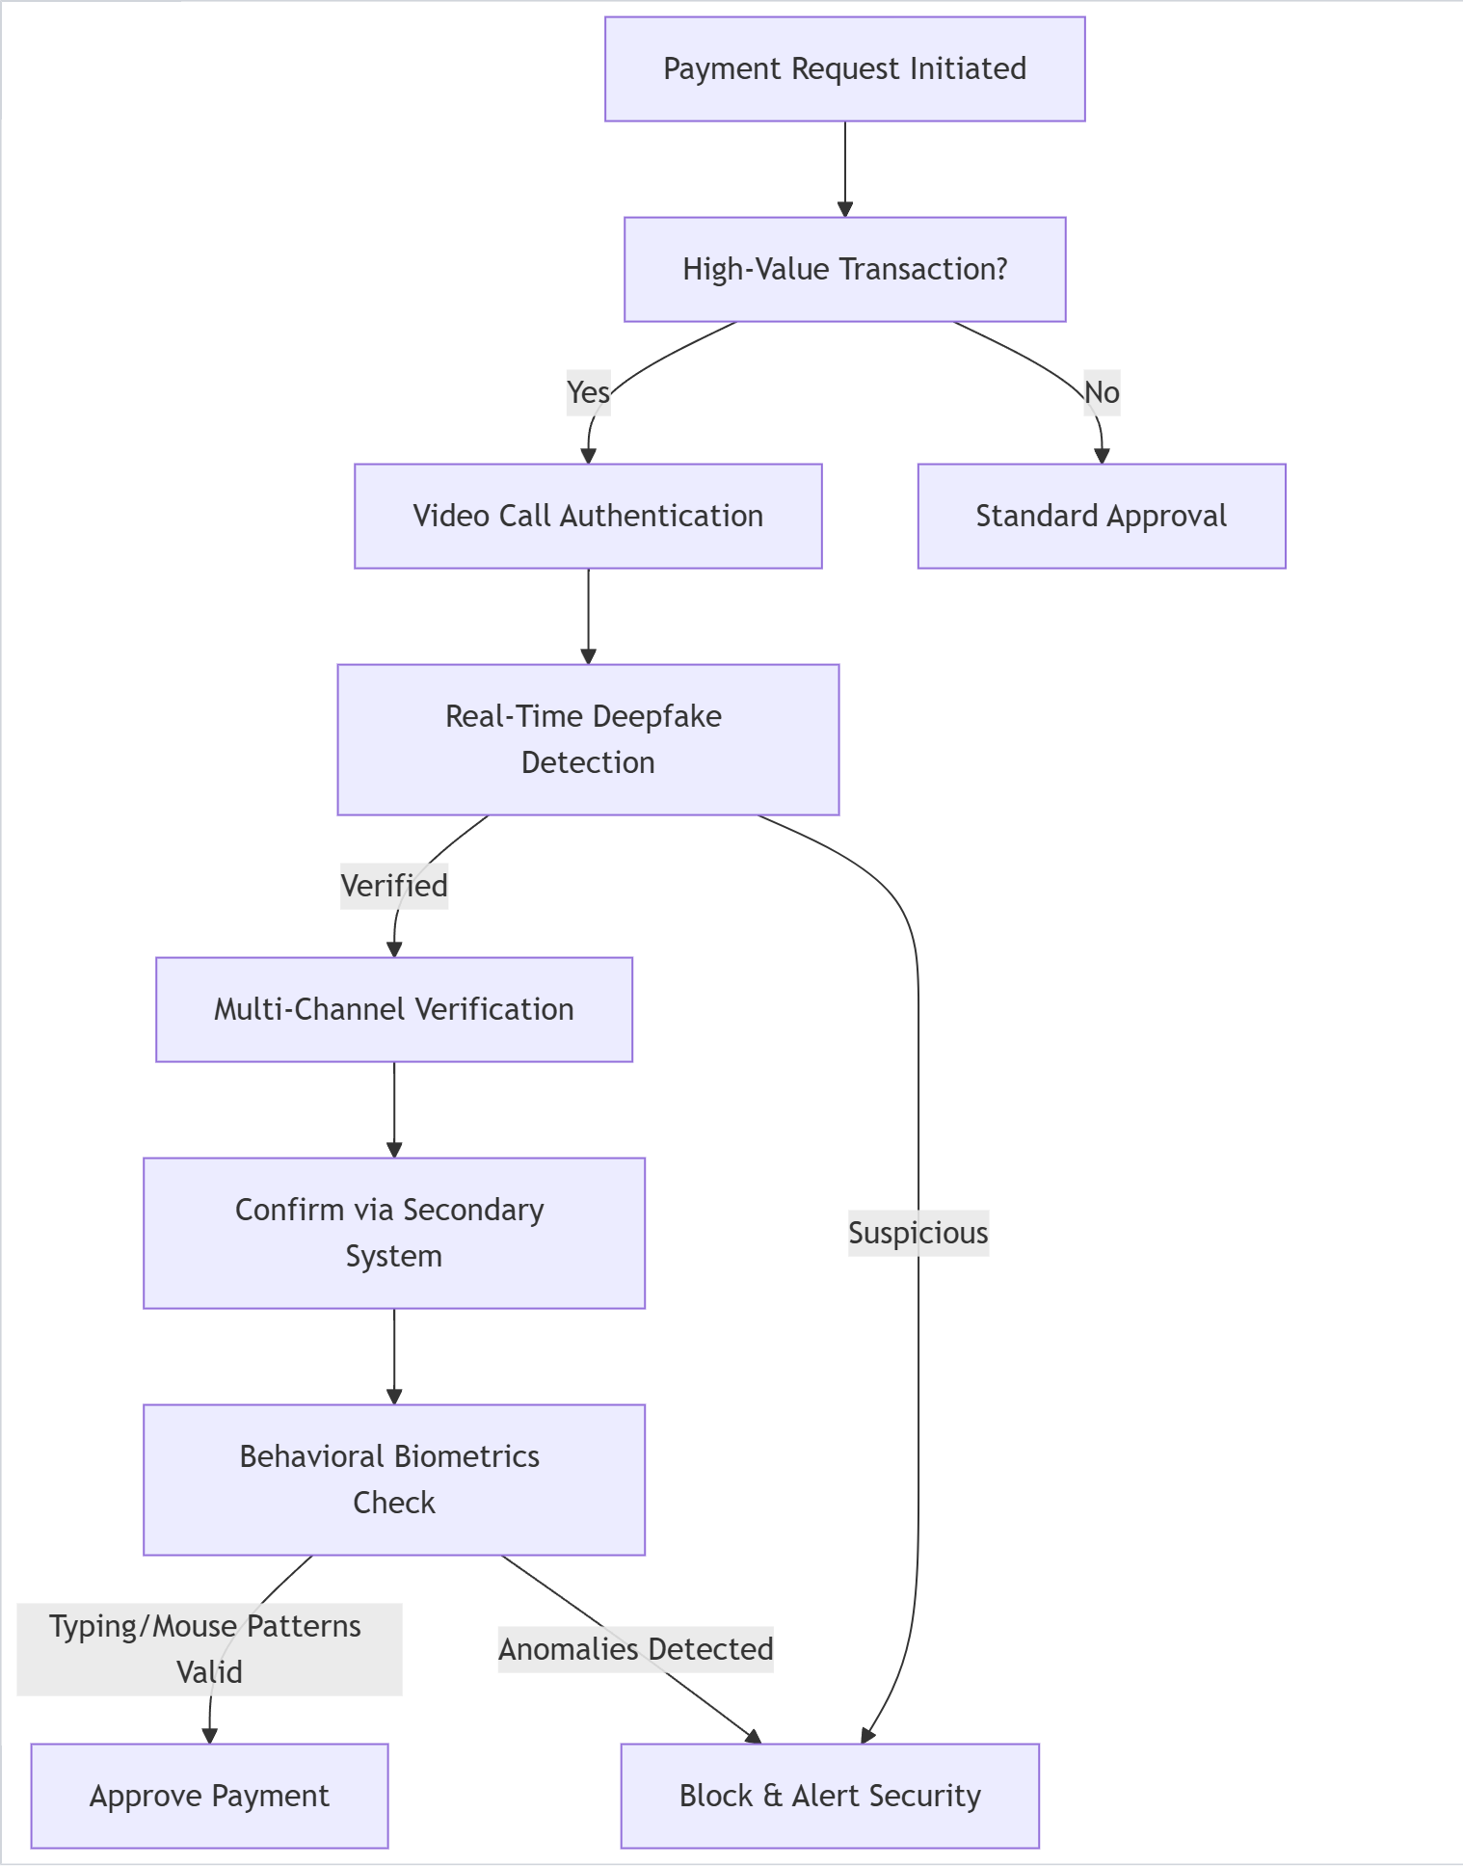
Flow-Chart

Slide 15
Problem 04
Vendor Identity Assurance System
Components:
Digital Certificates: For all SAP-certified partners
Phoneme-Viseme Analysis: Detects audio/video mismatches in communications
Secure Partner Portal: Dedicated authenticated channel
Attackers may pose as SAP-certified vendors or partners, using deepfake audio or video to trick procurement teams into altering payment details or approving fake contracts in SAP Ariba or other tools.

Slide 16
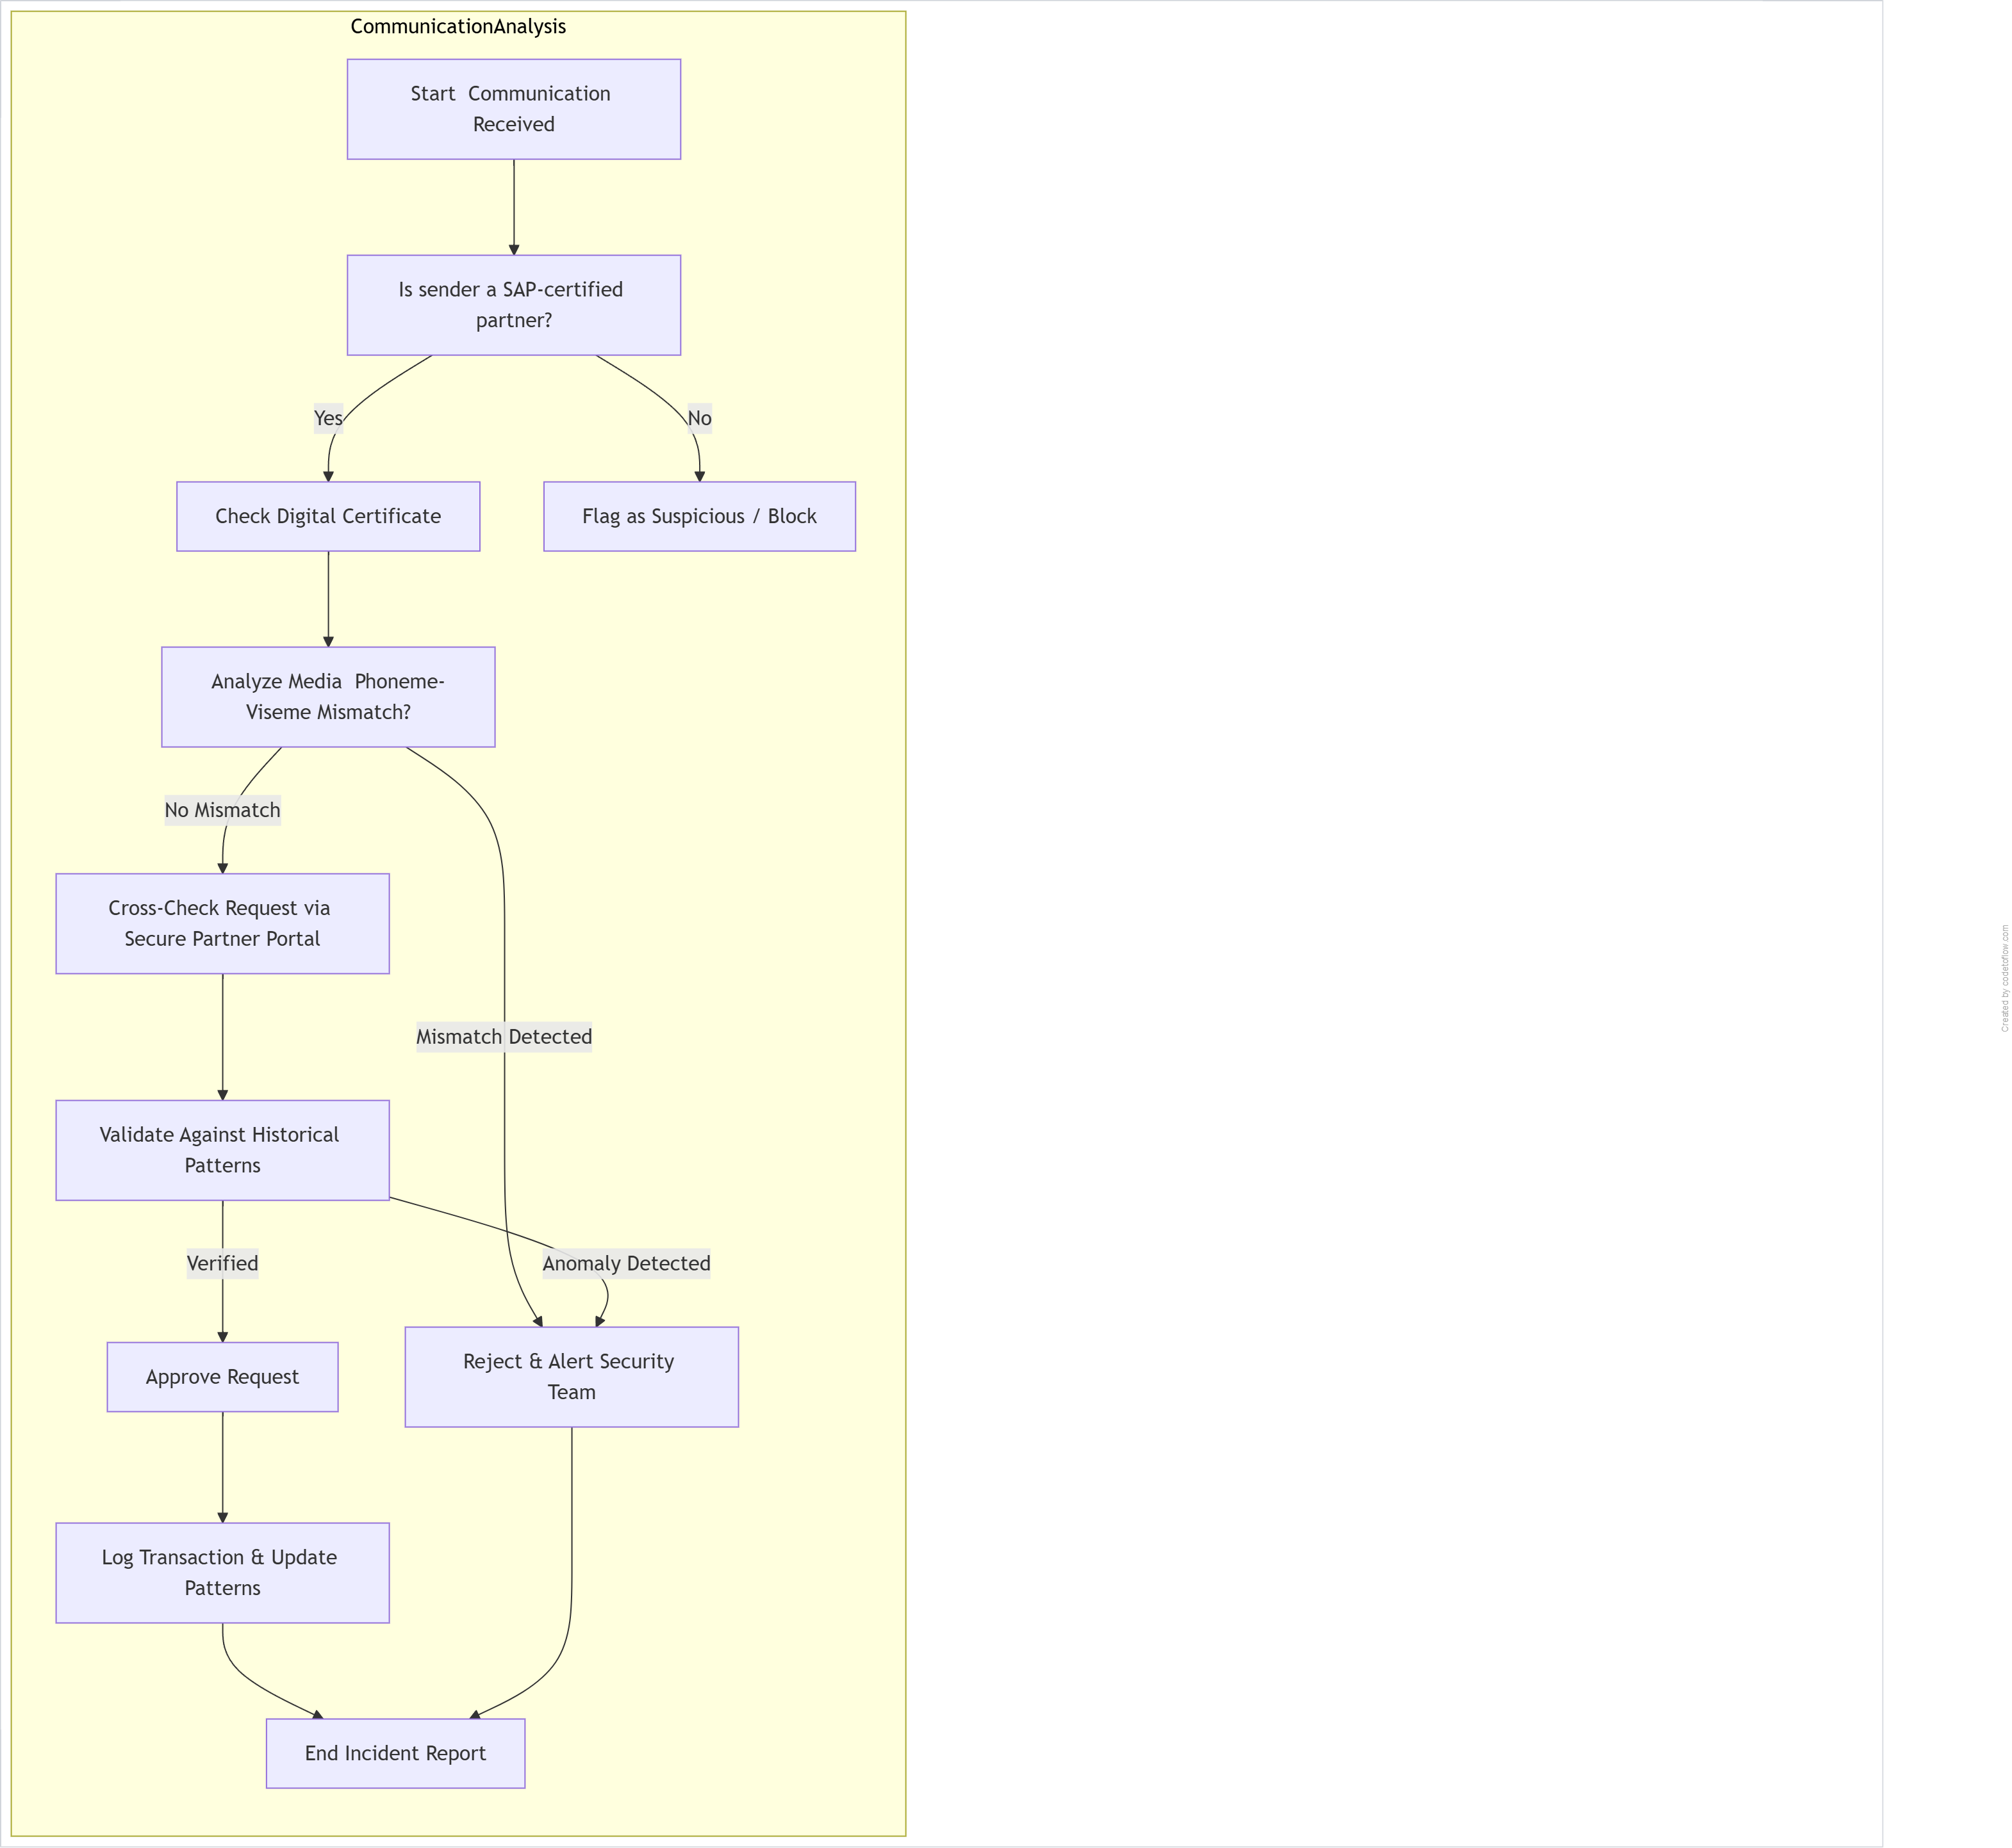
Flow-Chart

Slide 17

Conclution
Our business plan outlines the strategy for [company name], a [legal structure] that provides [products/services] to [target market]. Our mission is to [mission statement/goal of the company]
The market analysis shows that there is a high demand for our products/services in the industry. We have identified key competitors and believe we can differentiate ourselves through our unique selling propositions (USPs)

Slide 18
References
Here’s some references
Research paper Link_1
Research paper Link_2
Research_paper Link_3
Blog Link_1

Slide 19
Thanks!
Do you have any questions?
Avijit Roy
Aditya Basak
Mausham Prasad
Aritra Sinha
Company name

Slide 20
Thanks!
Do you have any questions?
Avijit Roy
Aditya Basak
Mausham Prasad
Aritra Sinha
Team
The Loop Breakers
HACKFEST 2025

